Slide 1
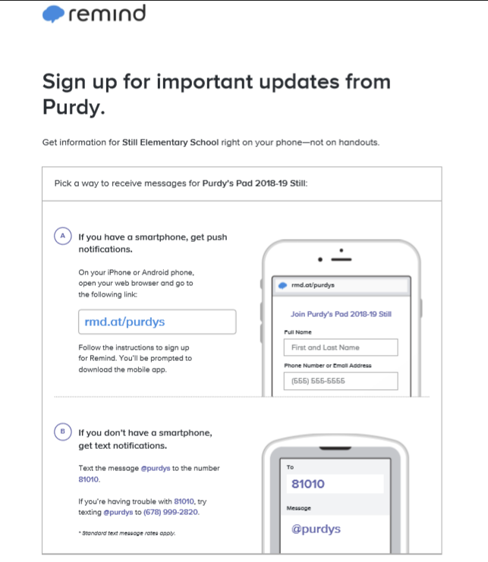
Welcome to Mrs. Purdy’s 5th grade Class
Please take a moment to log into Remind101 using the instructions to the left.
In the folder on the desk is important information we would like you to fill out before leaving ☺
Thank you for all you do each and Every day!

Slide 2
2018-2019

Slide 3
Still Elementary 870 Casteel Road, powder Springs, 30127 678-594-8287
Staff Member | Position | Email
Dr. Michelle L. Pearce | Principal | Michelle.Pearce@cobbk12.org
Sara Hood | Assistant Principal | Sara.Hood@cobbk12.org
Blair Ivey | Administrator | Blair.Ivey@cobbk12.org
George Morgan | SSA | George.Morgan@cobbk12.org
Candace Harbour | Instructional Specialist | Candace.Harbour@cobbk12.org
Dr. Missy Johnson | Counselor | Missy.Bradley-Johnson@cobbk12.org
Elizabeth Grant | Counselor | Elizabeth.Grant@cobbk12.org

Slide 4
School hours
Arrival
Doors open at 7:10 a.m.
Tardy bell rings at 7:45 a.m. Parents must sign in his/her child if tardy.
Dismissal
Dismissal begins at 2:10 p.m.
After School Program (ASP) is open until 6:00 p.m. All students in the building MUST be registered for ASP.
* Please have picture ID available when signing in and/or out of the building.

Slide 5
buses
Driver | Bus # | Color
Donna Walker | 2078 | Purple/Light Purple
Richard Croft | 2172 | Orange/Light Orange
David Pine | 2058 | Green
Kim Eidson | 1859 | Blue
Vickie Boyd | 2012 | Black
Cathy Canup | 1942 | Red
Bob Montgomery | 1614 | White
* We also have Special Education and Daycare buses that drop off and pick up.
* Please visit the Cobb County website here for more information.

Slide 6
Transportation changes
You MUST send in a signed note stating the transportation change if your child will be going home a different way from his/her regular transportation method
No transportation changes will be accepted after 1:00 p.m.
A bus pass must be completed if your child is riding home on a different bus
Click here to download a copy of the bus pass

Slide 7
cafeteria
Breakfast
Served from 7:10 – 7:40 a.m. daily
Student price $1.50
Lunch
Served daily (check with homeroom teacher for specific time)
Guests are welcome to eat lunch with your child in the cafeteria any day
Student price $2.35/daily
Guest price $3.75/daily
* Please visit the Cobb County website here for more information

Slide 8
Notes from the Nurse
If your child needs medication administered during the school day, please click here to download the appropriate form. No medication will be dispensed without proper documentation.
If your child has a fever over 100 degrees, he/she must be fever-free, without medications (i.e. Tylenol, ibuprofen, etc.), for 24 hours before returning to school.
If your child is sick, he/she must have no symptoms of vomiting or diarrhea for 24 hours before returning to school.

Slide 9
Please visit Still’s website for more information

Slide 10
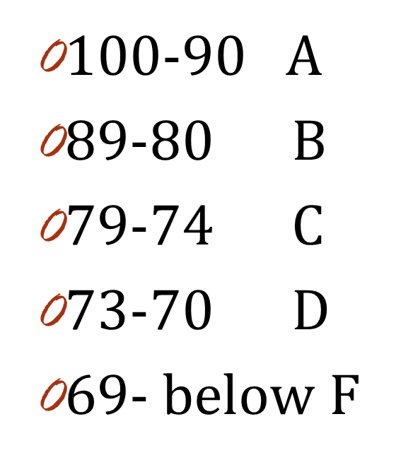
Grading
Tests & Projects are counted twice.
Classwork, Quizzes, & Participation are counted once.
Language Skills is weighted 40% of Language Arts.
Writing is weighted 60% of Language Arts.

Slide 11
Work/Homework
Homework will be given on a needs bases. Students should be reading daily for 30 minutes each day and practicing their math facts.
Incomplete assignments in class will be taken home to complete.
Students have a choice to redo all work below a C.
Requirements:
Must answer missed questions on a separate sheet of paper
Staple to the original paper

Slide 12
Behavior Management
Students will receive a Star Sheet where behavior problems will be documented.
Five infractions in a nine week period may result in a detention.
Students may be referred to the office after the third parent/guardian contact concerning behavior issues.

Slide 13
Communication
Email is the best way to contact me
Bridget.Purdy@cobbk12.org
Also refer to my blog, Remind 101, and the newsletter for more information that is going on within the class.

Slide 14
Daily Schedule
8:00-9:00 Math
9:05-10:05 Writing
10:05-10:20 Recess
10:20-11:38 Reading
11:51-12:21 Lunch
12:25-1:10 Specials
Day 1- PE / Day 2- Music / Day 3-STEM / Day 4-PE / Day 5- Art 1:10-1:25 Number Talks 1:25-2:00 Science / Social Studies

Slide 15
Questions

