Slide 1
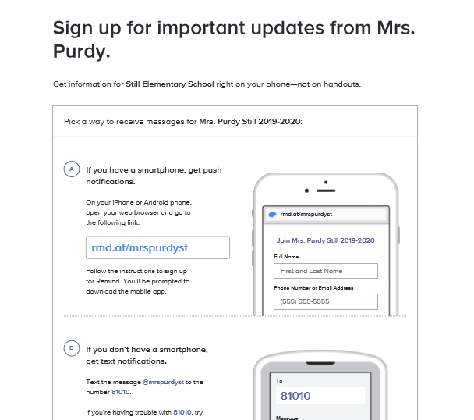
Welcome to Mrs. Purdy’s 5th grade Class
Please take a moment to log into Remind101 using the instructions to the left.
In the folder on the desk is important information we would like you to fill out before leaving ☺
Thank you for all you do each and Every day!

Slide 2
2019-2020

Slide 3
Still Elementary 870 Casteel Road, powder Springs, 30127 678-594-8287
Staff Member | Position | Email
Dr. Michelle L. Pearce | Principal | Michelle.Pearce@cobbk12.org
Sara Hood | Assistant Principal | Sara.Hood@cobbk12.org
Tamela Isley | Administrator | Tamela.Isley@cobbk12.org
Renae Kiger | SSA | Renae.Kiger@cobbk12.org
Candace Harbour | Instructional Specialist | Candace.Harbour@cobbk12.org
Dr. Missy Johnson | Counselor | Missy.Bradley-Johnson@cobbk12.org
Kristin Hartzheim | Counselor | Kristin.Hartzheim@cobbk12.org

Slide 4
School hours
Arrival
Doors open at 7:10 a.m.
Tardy bell rings at 7:45 a.m. Parents must sign in his/her child if tardy.
Dismissal
Dismissal begins at 2:10 p.m.
After School Program (ASP) is open until 6:00 p.m. All students in the building MUST be registered for ASP.
* Please have picture ID available when signing in and/or out of the building.

Slide 5
buses
Driver | Bus # | Color
Donna Walker | 2198 | Purple
Kim Eidson | 1859 | Blue
Shiloh Evans | 1938 | Black
David Pine | 2133 | Green
Richard Croft | 2200 | Orange
Cathy Haley | 1942 | Red
Melissa Baker | 2012 | White
* Please register for “Here Comes the Bus” here and use the code 87881.
* Please visit the Cobb County website here for more information.

Slide 6
Morning Carpool procedures
Due to staffing changes, there will be less personnel at morning car duty. To facilitate drop-off, please do the following:
Have your child seated on the right side of the vehicle
Allow your child to exit the vehicle independently
Do not wait for a staff member to open the car door

Slide 7
Transportation changes
You MUST send in a signed note stating the transportation change if your child will be going home a different way from his/her regular transportation method
No transportation changes will be accepted after 1:00 p.m.
A bus pass must be completed if your child is riding home on a different bus
Click here to download a copy of the bus pass

Slide 8
cafeteria
Breakfast
Served from 7:10 – 7:40 a.m. daily
Student price $1.50
Lunch
Served daily (check with homeroom teacher for specific time)
Guests are welcome to eat lunch with your child in the cafeteria any day
Student price $2.35/daily
Guest price $4.00/daily
* Please visit the Cobb County website here for more information

Slide 9
Notes from the Nurse
If your child needs medication administered during the school day, please click here to download the appropriate form. No medication will be dispensed without proper documentation.
If your child has a fever over 100 degrees, he/she must be fever-free, without medications (i.e. Tylenol, ibuprofen, etc.), for 24 hours before returning to school.
If your child is sick, he/she must have no symptoms of vomiting or diarrhea for 24 hours before returning to school.
For Kindergarten and 1st Grade students, please pack an extra set of clothes in the bookbag in case of accidents.

Slide 10
Please visit Still’s website for more information

Slide 11
Grade level information

Slide 12
GradING
Grading is based on the Cobb County grading scale:
A: 90 - 100
B: 80 - 89
C: 74 – 79
D: 70 – 73
F: 69 – Below
All grade levels will send a 4 ½ week progress report for students performing below a C in 4th and 5th grades. A progress report will also be sent for any student dropping more than 2 letter (or number) grades in a subject area.

Slide 13
Homework
Reading nightly is strongly recommended.
Any assignments not completed in class need to be completed for homework.
All students have something to improve.
Study skills should be practiced regularly.

Slide 14
Behavior Management
5th Grade implements a Star Sheet behavior management system.
Star Sheets are kept in students’ binders/folders and are responsible for them.
After 5 Stars have been taken, teacher email or conference will be scheduled.
10 stars in an individual category (behavior/responsibility) will constitute an N on the report card (conduct/work/study habits).
Please check Star Sheets regularly, sign, and discuss with your student.

Slide 15
Communication
Remind101
Blog
Bi-weekly Newsletter
Email Bridget.Purdy@cobbk12.org
School & PTSA Websites

Slide 16
Daily Schedule
Lunch: 10:40 – 11:50
Specials: 12:15 – 1:00
Math 60 minutes
Writing 45-60 min
Reading Block 90 minutes
Number Talks 15-20 minutes
Content- 30 minutes

Slide 17
ParentVue
If you have not pick up your ParentVUE access codes yet, they will be located in the hallway outside the 4th/5th grade wing.

Slide 18
Questions

